Slide 1
INFERMIERISTICA AEROSPAZIALE
I sensi dell’assistere: un senso per una professione in divenire
Francesco Satiro
Specialist degli Accessi Venosi
Space Nursing Society
francysat@live.it

Slide 2
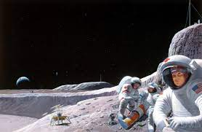
Space Missions
Human
Astronauts Healtcare
Countermeasures
Aerospace Engineering
Space Medicine
Space Nursing
Rogers
O’Hara
Plush
???
???
Innovation
Basic nursing
Space Nursing society
lplushsn@ix.netcom.com

Slide 3
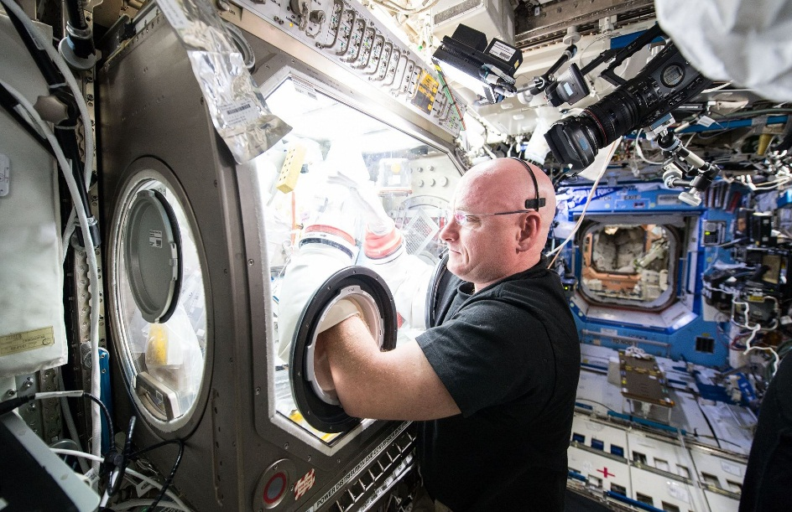
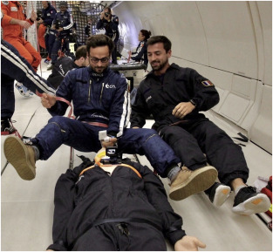
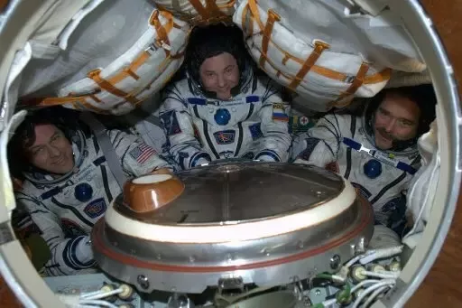
IN VITRO
Physiology
-NEUROLOGICAL, VESTIBULAR AND VISUAL
-CARDIOVASCULAR AND RESPIRATORY
-BONE AND MUSCULAR
-HEMATOPOIETIC
-DIGESTIVE AND IMMUNE
-TEGUMENTARY
…
ANALOG SIMULATION
Case Report
Adaptive and Reactive response
Research
-ISOLATION
-ANXIETY
-DEPRESSION
…
REAL
Transcultural Nursing for example
Psychology

Slide 4
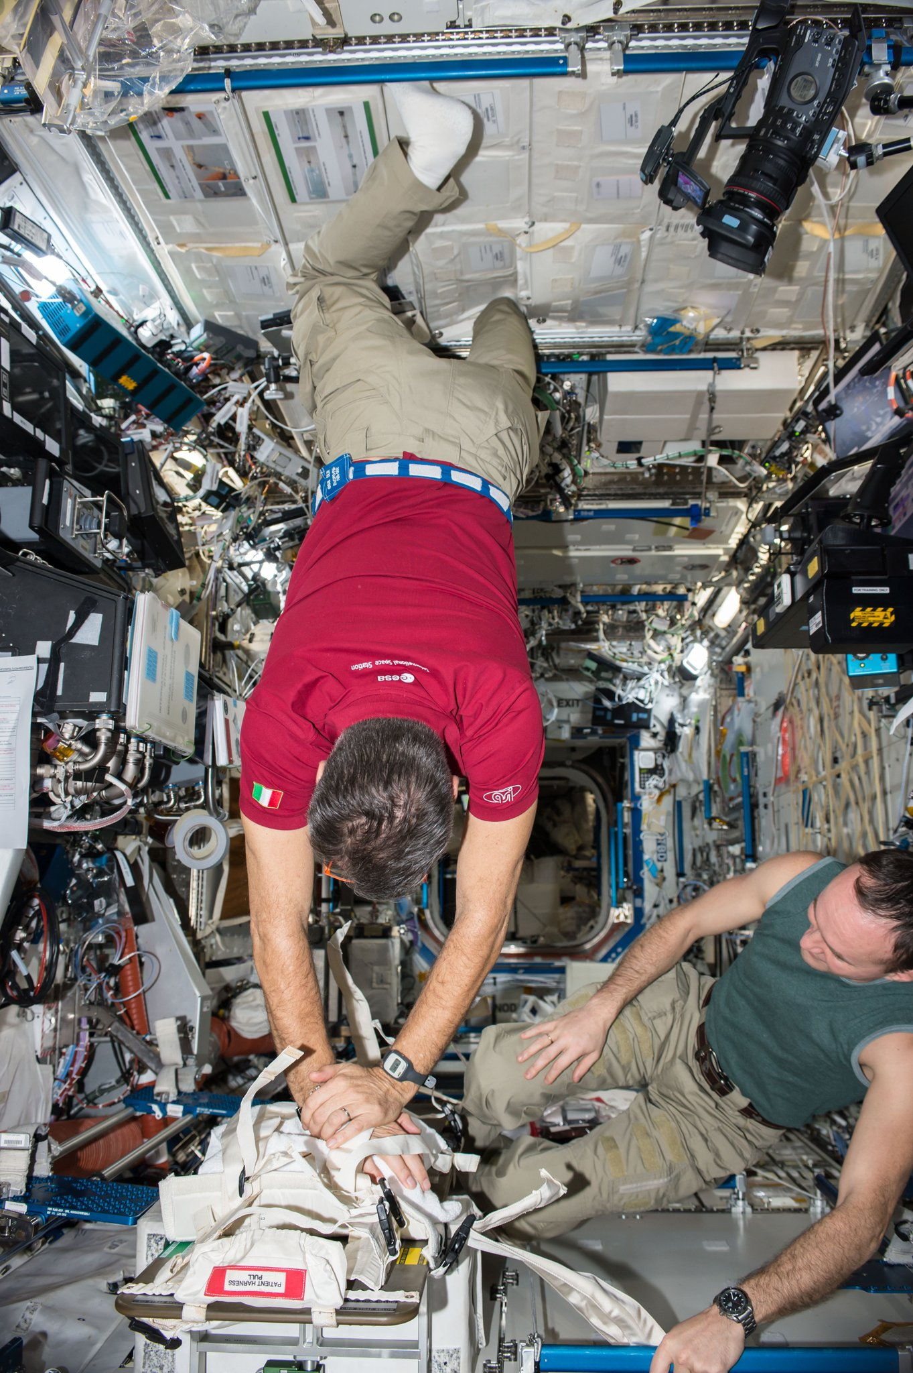
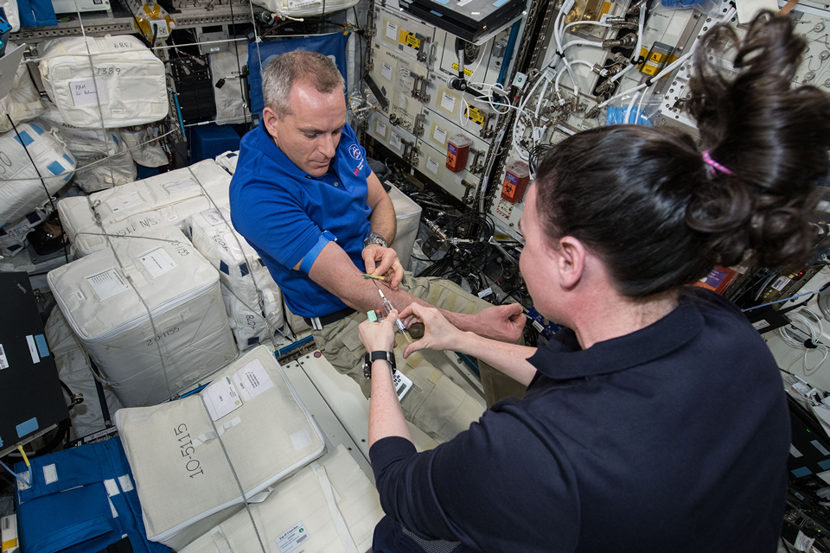
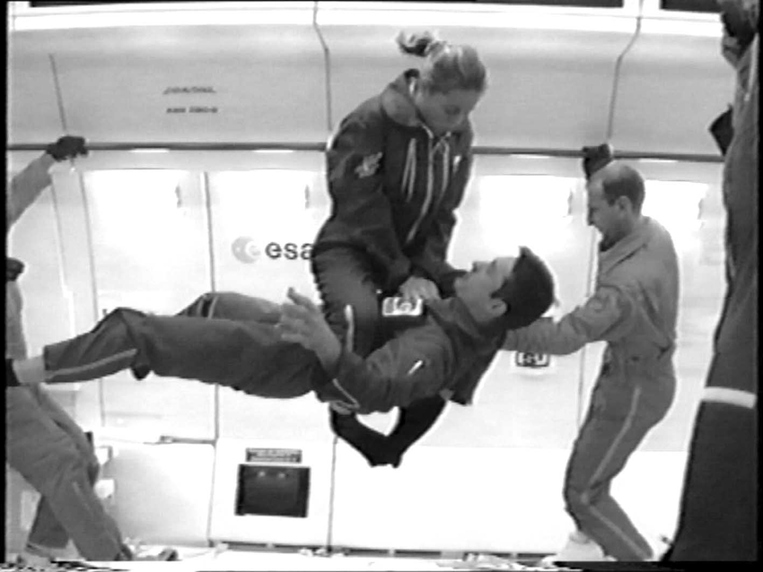
RAD
ISS - MOON
Drugs
New drugs
Sars CoV-2
Spaceflight
New devices
Cancer
Immune system
Oxygen
Emergency
Cardiovascular
CPR & AED
Dysbiosis
Check up stations
Quarantine
AEROSPACE NURSING
Venous system
Earth
Pre-flight
Post-flight
Self-isolation
Infusion
Nurse
Psychology
Prototype
Adaptation
Endemic Pandemic
Team
Robotic
Analog simulation
Culture
Risk management Infection control
Mars

Slide 5
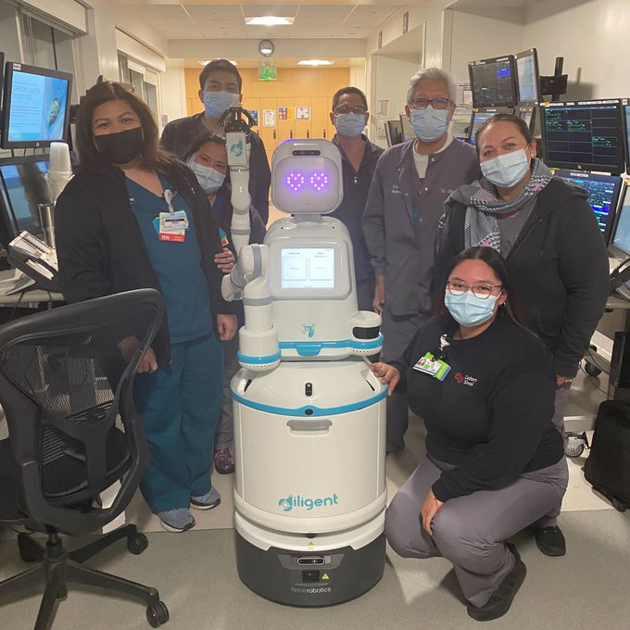
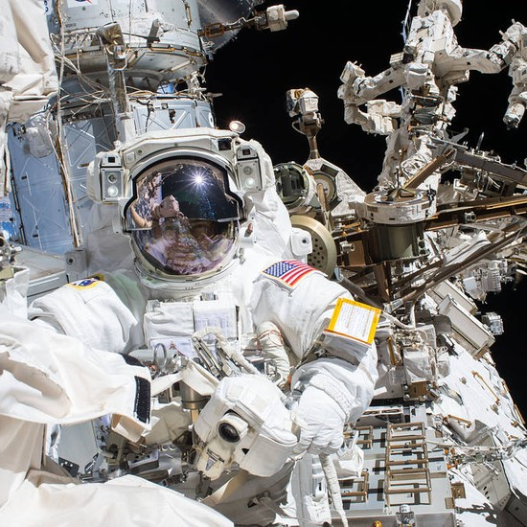
Nursing
Aerospace Nursing
Robotic Nursing
Grazie per l’attenzione
Francesco Satiro
critical nursing reasoning
Aerospace
Robotic
Aerospace and Robotic Nursing

